Slide 1

GIT - tips and tricks

Slide 2
Git ignore
Local – refers to a single repository – PROJECT_PATH/.gitignore
Global – refers to all respositories under one user - ~/.gitignore

Slide 3
Git commit
git commit – create a new commit
git commit –-amend – replace the tip of the current branch by creating a new commit. Can be use with –-no-edit option.
git commit –-fixup – fixup specific commit. The commit message will be subject line from commit with a prefix !fixup – useful option for rebase --autosquash

Slide 4
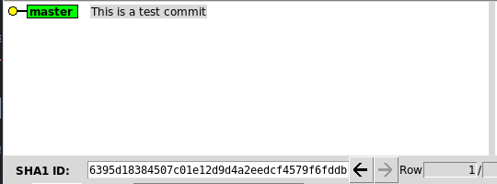
Fixup

Slide 5
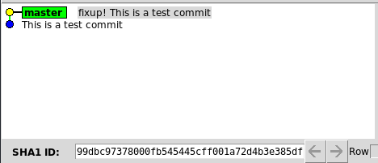
Fixup

Slide 6
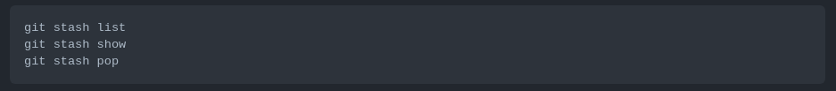
Git stash
Use git stash when you want to record the current state of the working directory and the index but want to go back to clean working directory.

Slide 7

Git fetch/pull
Delete local branches that have been removed from remote

Slide 8
Soft reset vs hard reset
git reset – reset current HEAD to te specified state
git reset –-soft - moves HEAD to the specified commit (or the index) without gettind rid of the changes that were intoduced on the commits afterwards
git reset –-hard – moved HEAD to the specified commit and don’t keep changes that were intoduced by commits afterwards

